Slide 1

Celeb Store: Designing an E-Commerce website for reselling celebrity outfits
By
Barla Sai Anjanna Reddy : 22311A6703
Balivada Pranitha: 22311A6711
C.Yogitha: 22311A6734

Slide 2
agenda
INTRODUCTION
KEY FEATURES
FUTURE ENHANCEMENTS
WEBSITE SNAPSHOTS
CONCLUSION

Slide 3
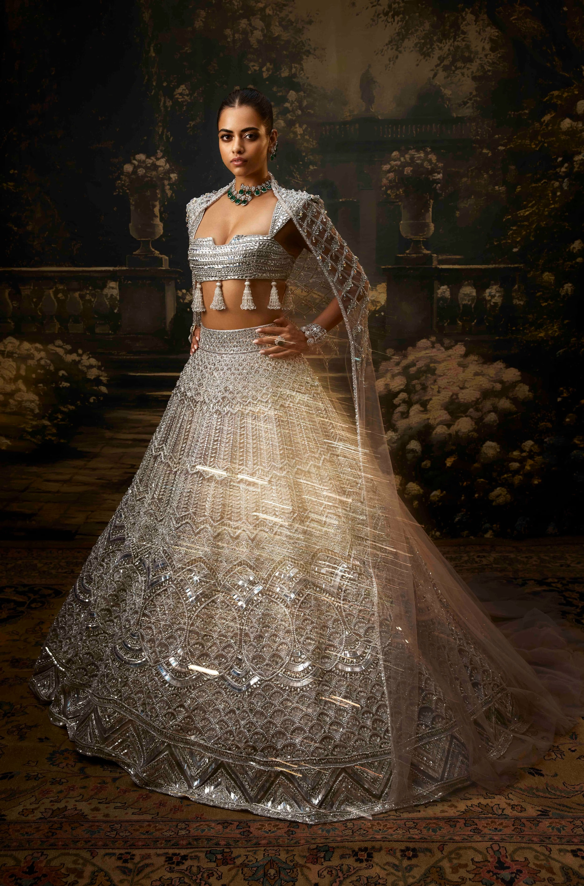
Introduction to Celeb Store:
Connecting Fans with Celebrity Attire
Unique Offering
Celeb Store is a one-stop shop for fans seeking authentic celebrity-worn items. Each item is carefully vetted to ensure authenticity, giving buyers peace of mind.
Sustainability
Beyond just a fashion marketplace, Celeb Store promotes sustainable fashion by giving clothes a second life, minimizing waste, and offering unique, pre-owned pieces to fans.

Slide 4
Key Features of the Celeb Store Website:
HTML and CSS Front-end
1)
Clean and Modern Design
2)
Intuitive Navigation
3)
Mobile-Friendly Interface
The website boasts a modern and user-friendly interface with a focus on showcasing products in a visually appealing way, using HTML and CSS for a dynamic and engaging experience.
Users can easily navigate through the website, browse various categories, and locate items they are interested in, thanks to clear and concise navigation menus and product filtering options.
The website is fully responsive, providing a seamless shopping experience on all devices, including smartphones and tablets, optimizing the layout and features for the best user experience.

Slide 5
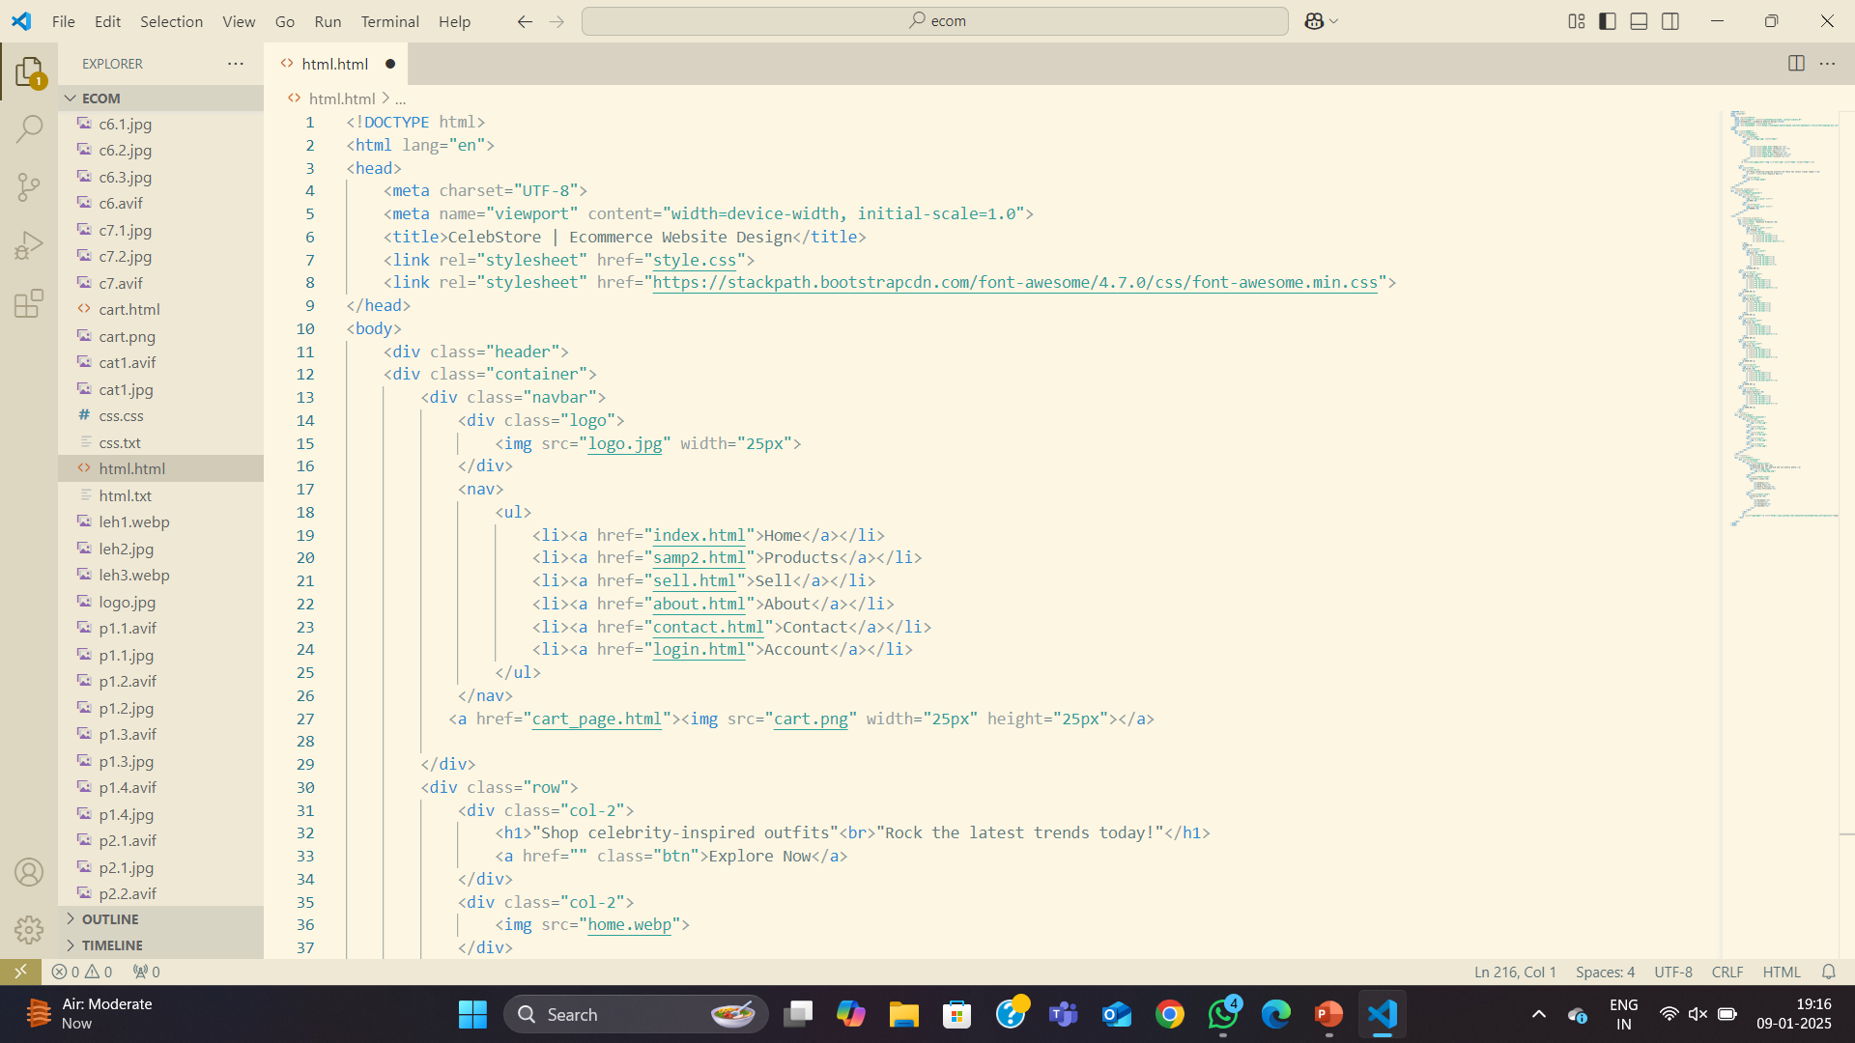
Snapshots of Code

Slide 6
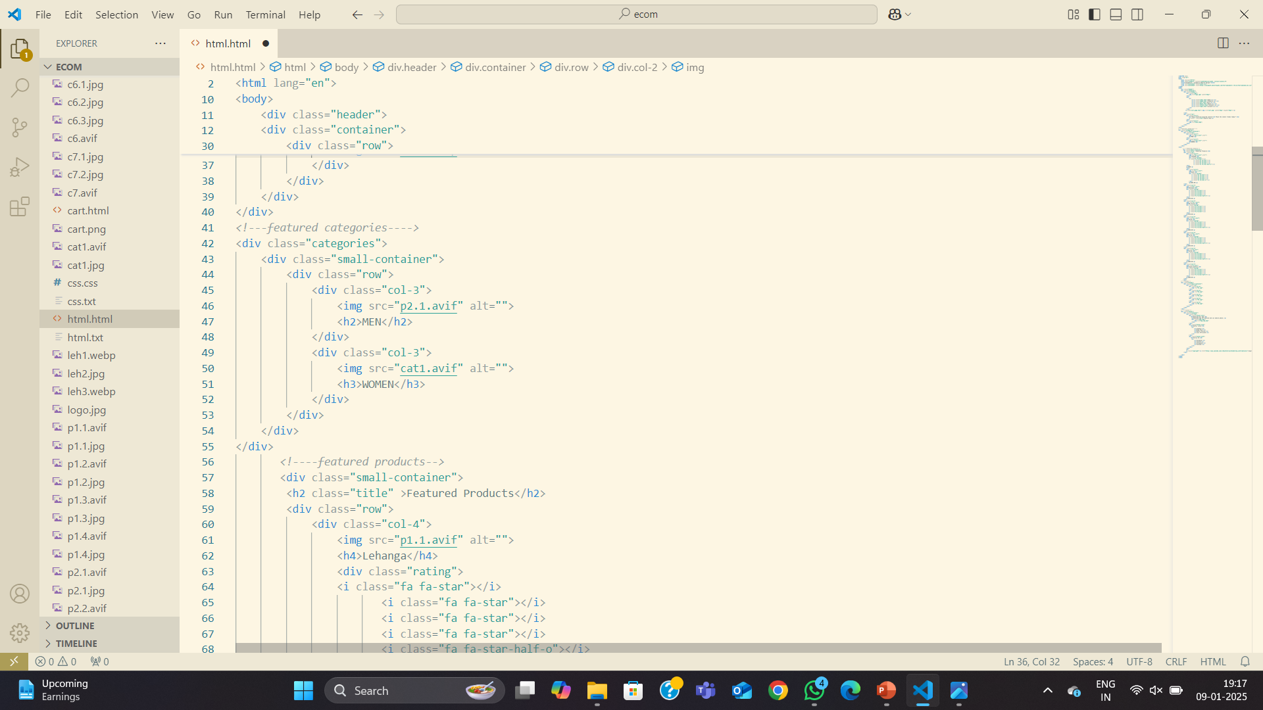
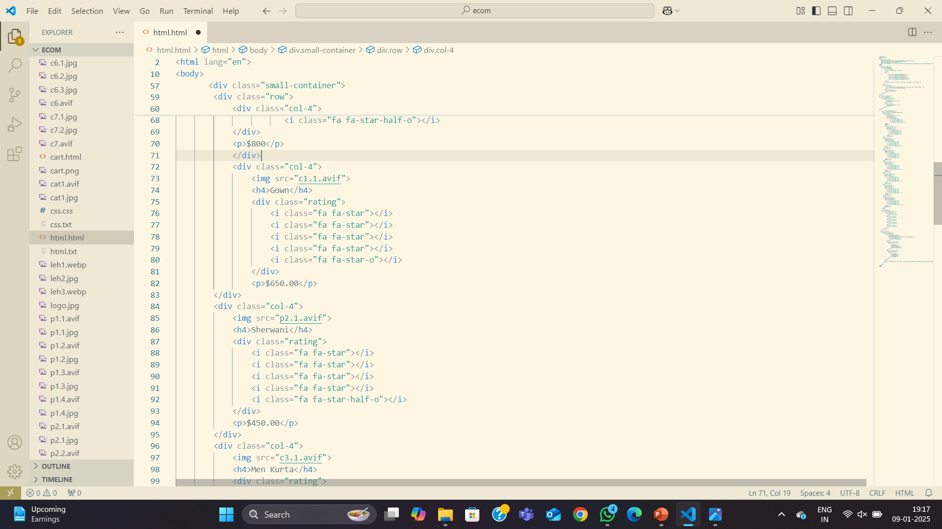

Slide 7
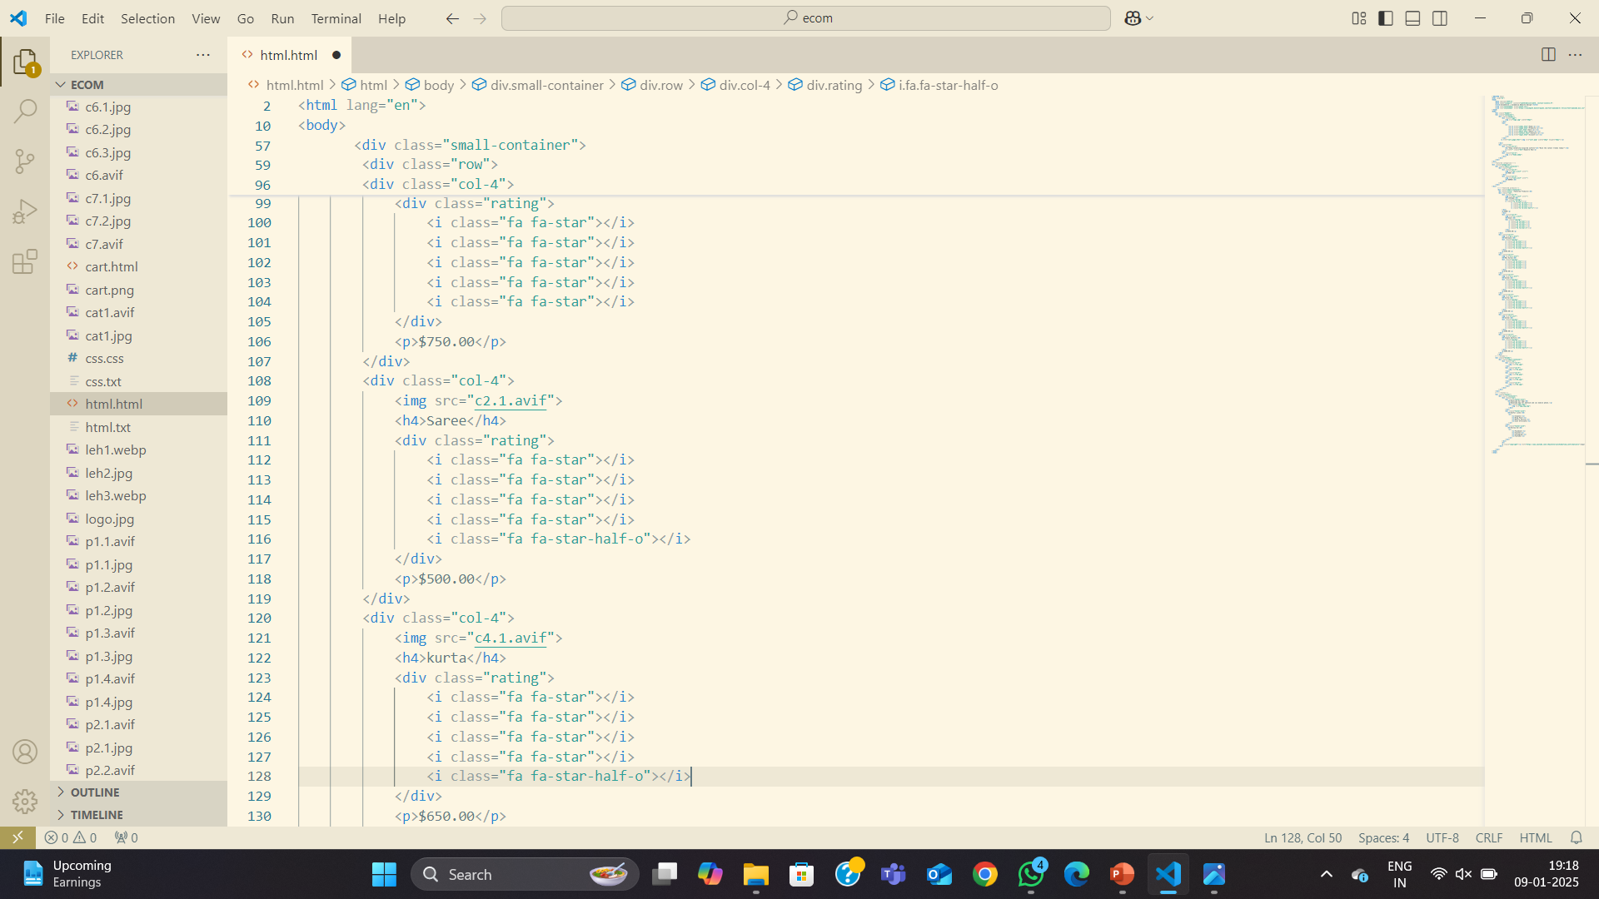
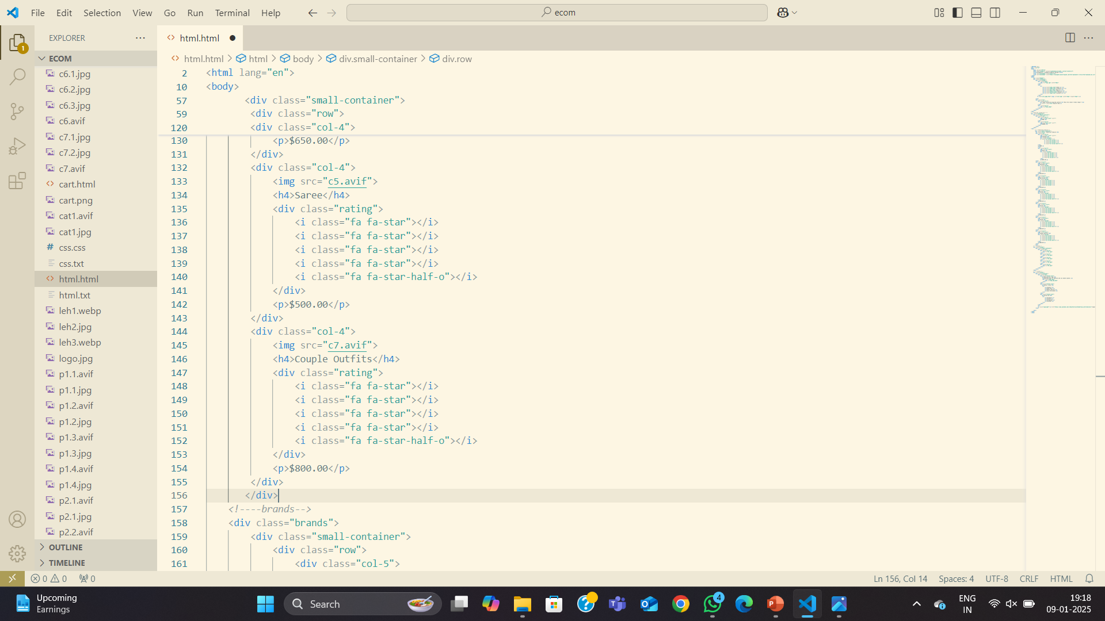

Slide 8
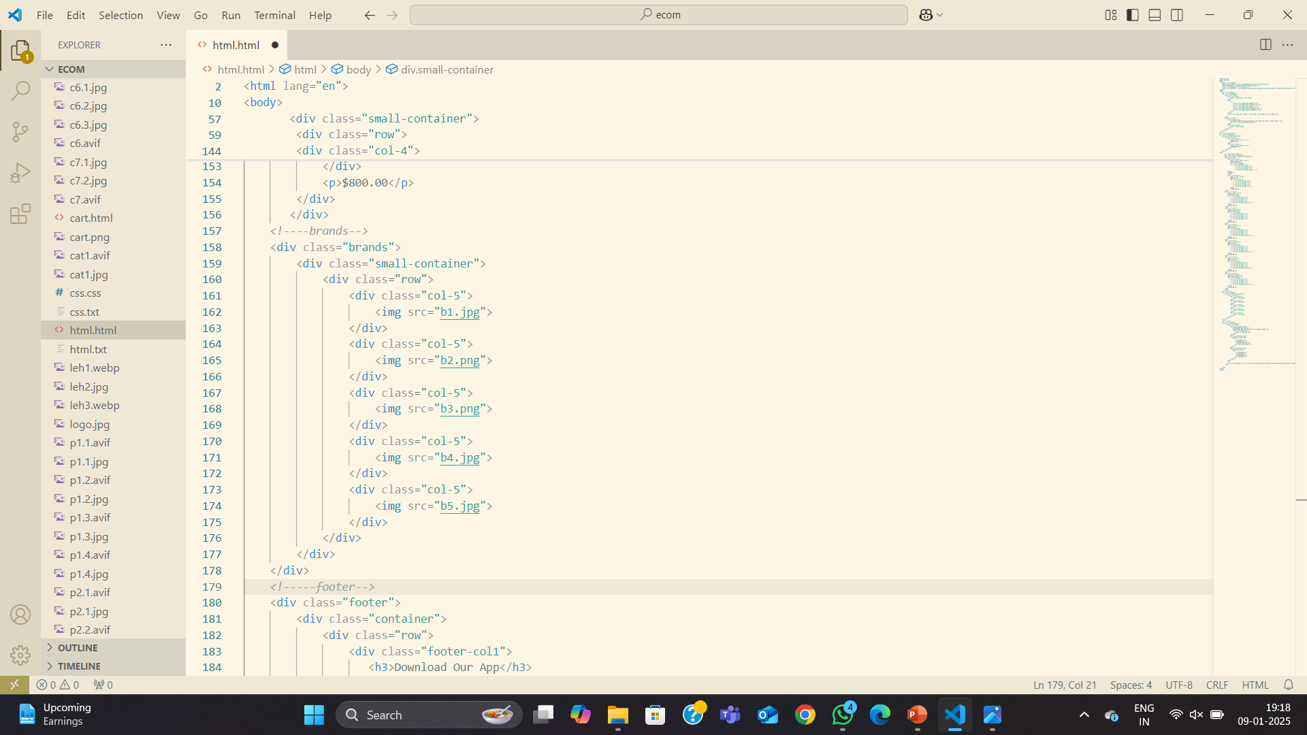
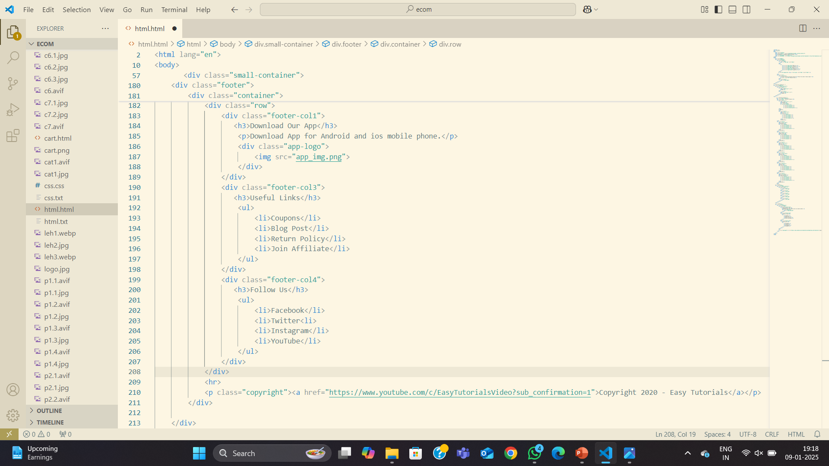

Slide 9
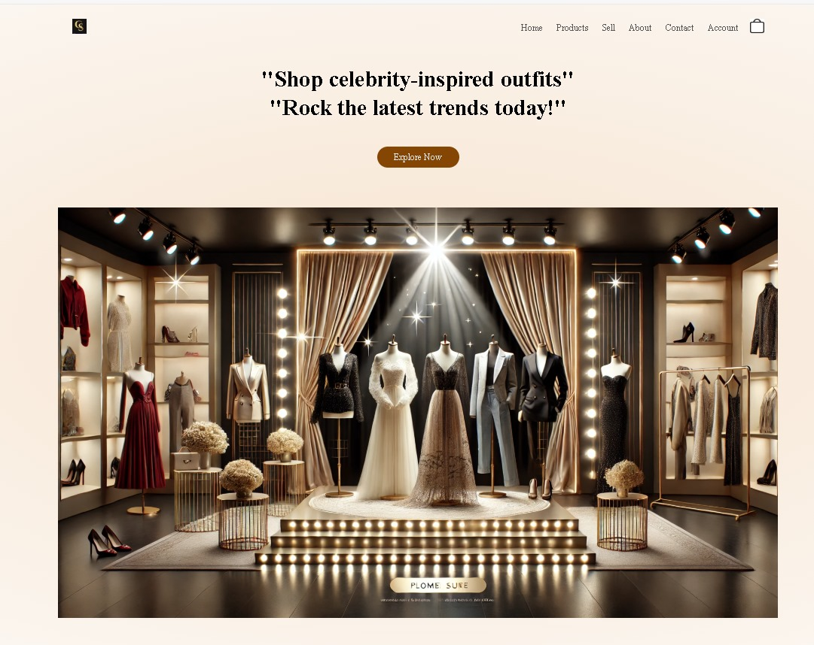
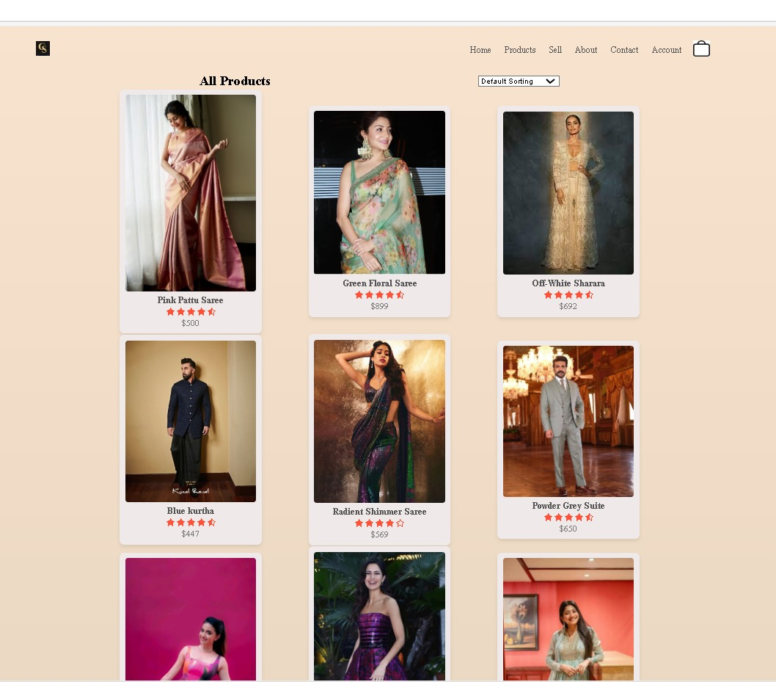
Snapshots of website

Slide 10
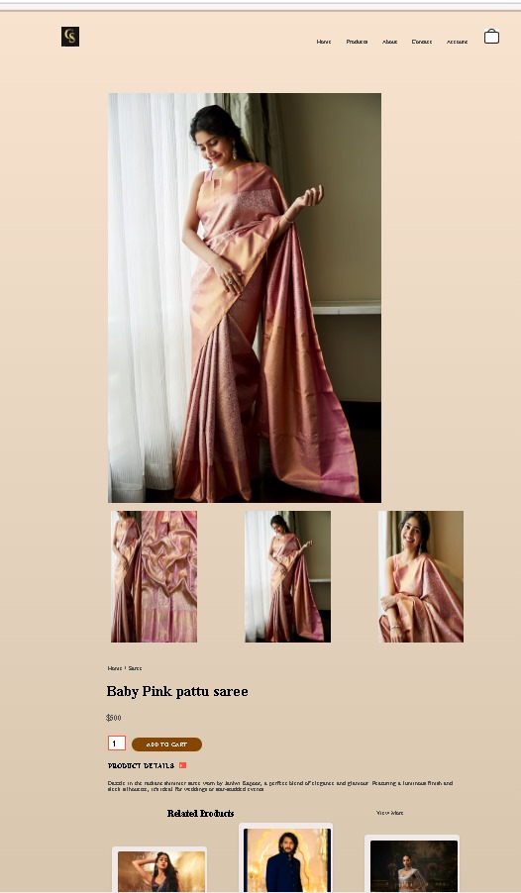
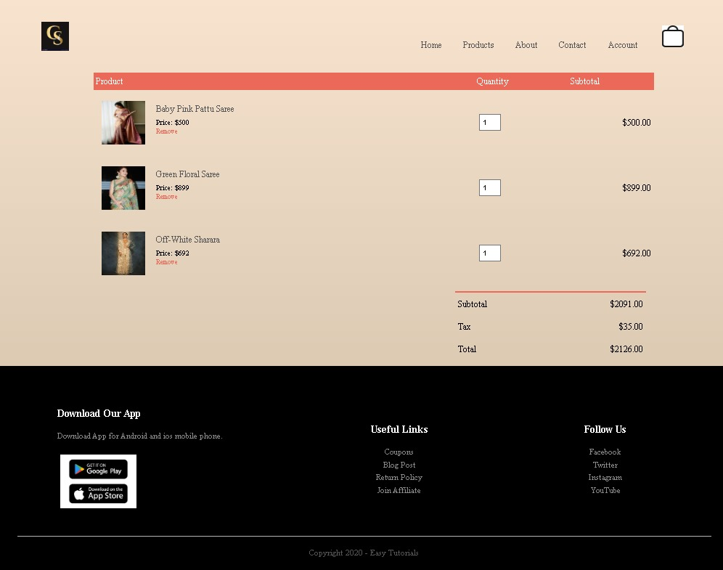

Slide 11
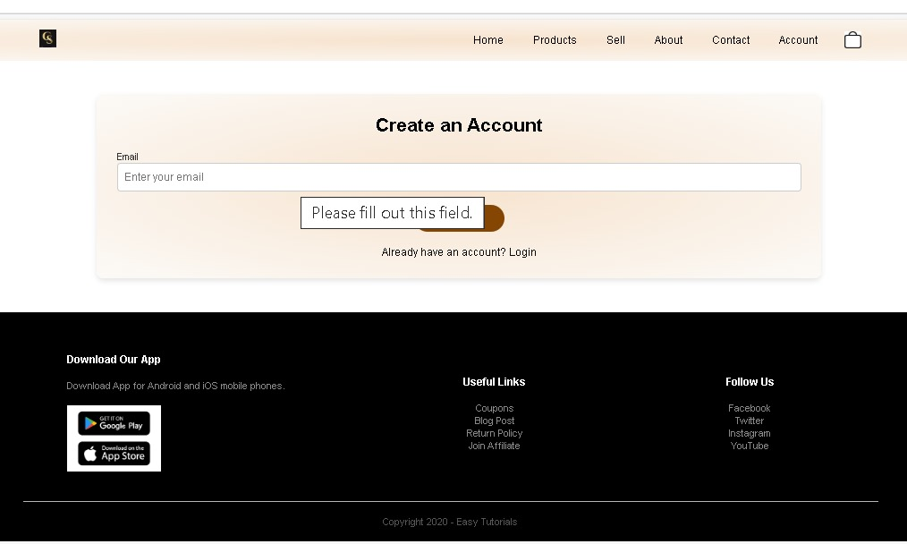
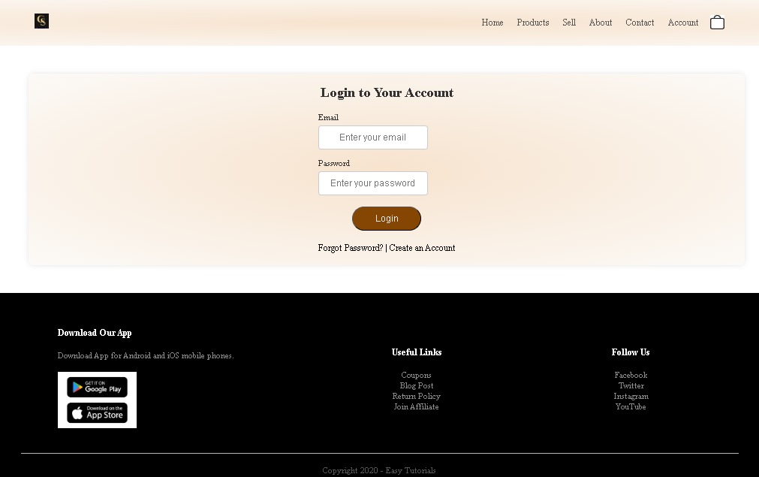

Slide 12
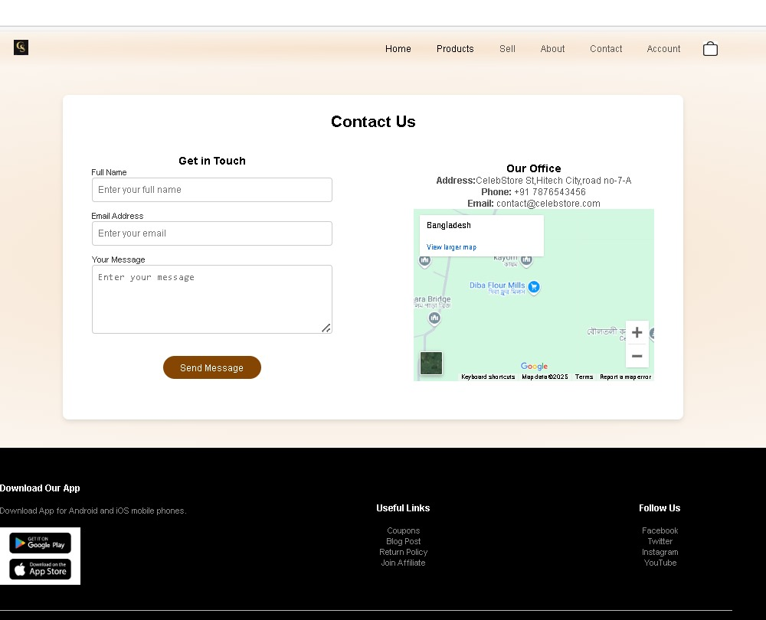
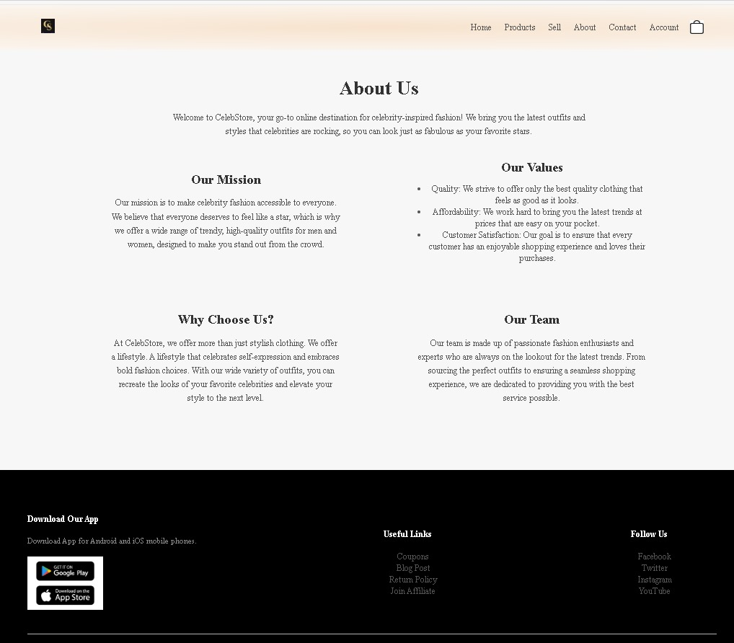

Slide 13
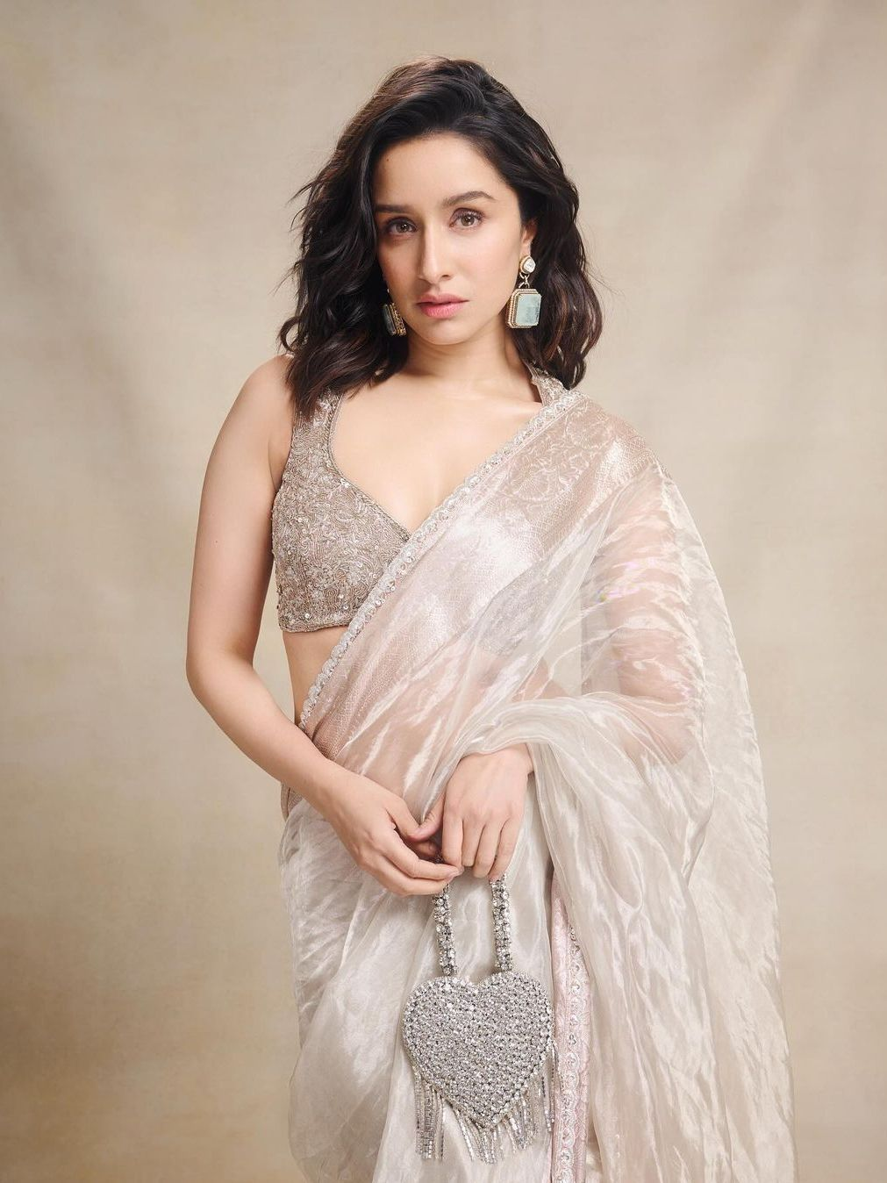
Future Enhancements: Personalized Shopping Experience
Personalized Recommendations
Customizable Wishlists
Create wishlist to track favorites, share with friends, and receive instant restock notifications effortlessly!
The platform leverages user data to deliver personalized and relevant product recommendations.
Personalized Notifications
Users receive alerts on new arrivals, exclusive deals, and wishlist sales to boost engagement.

Slide 14
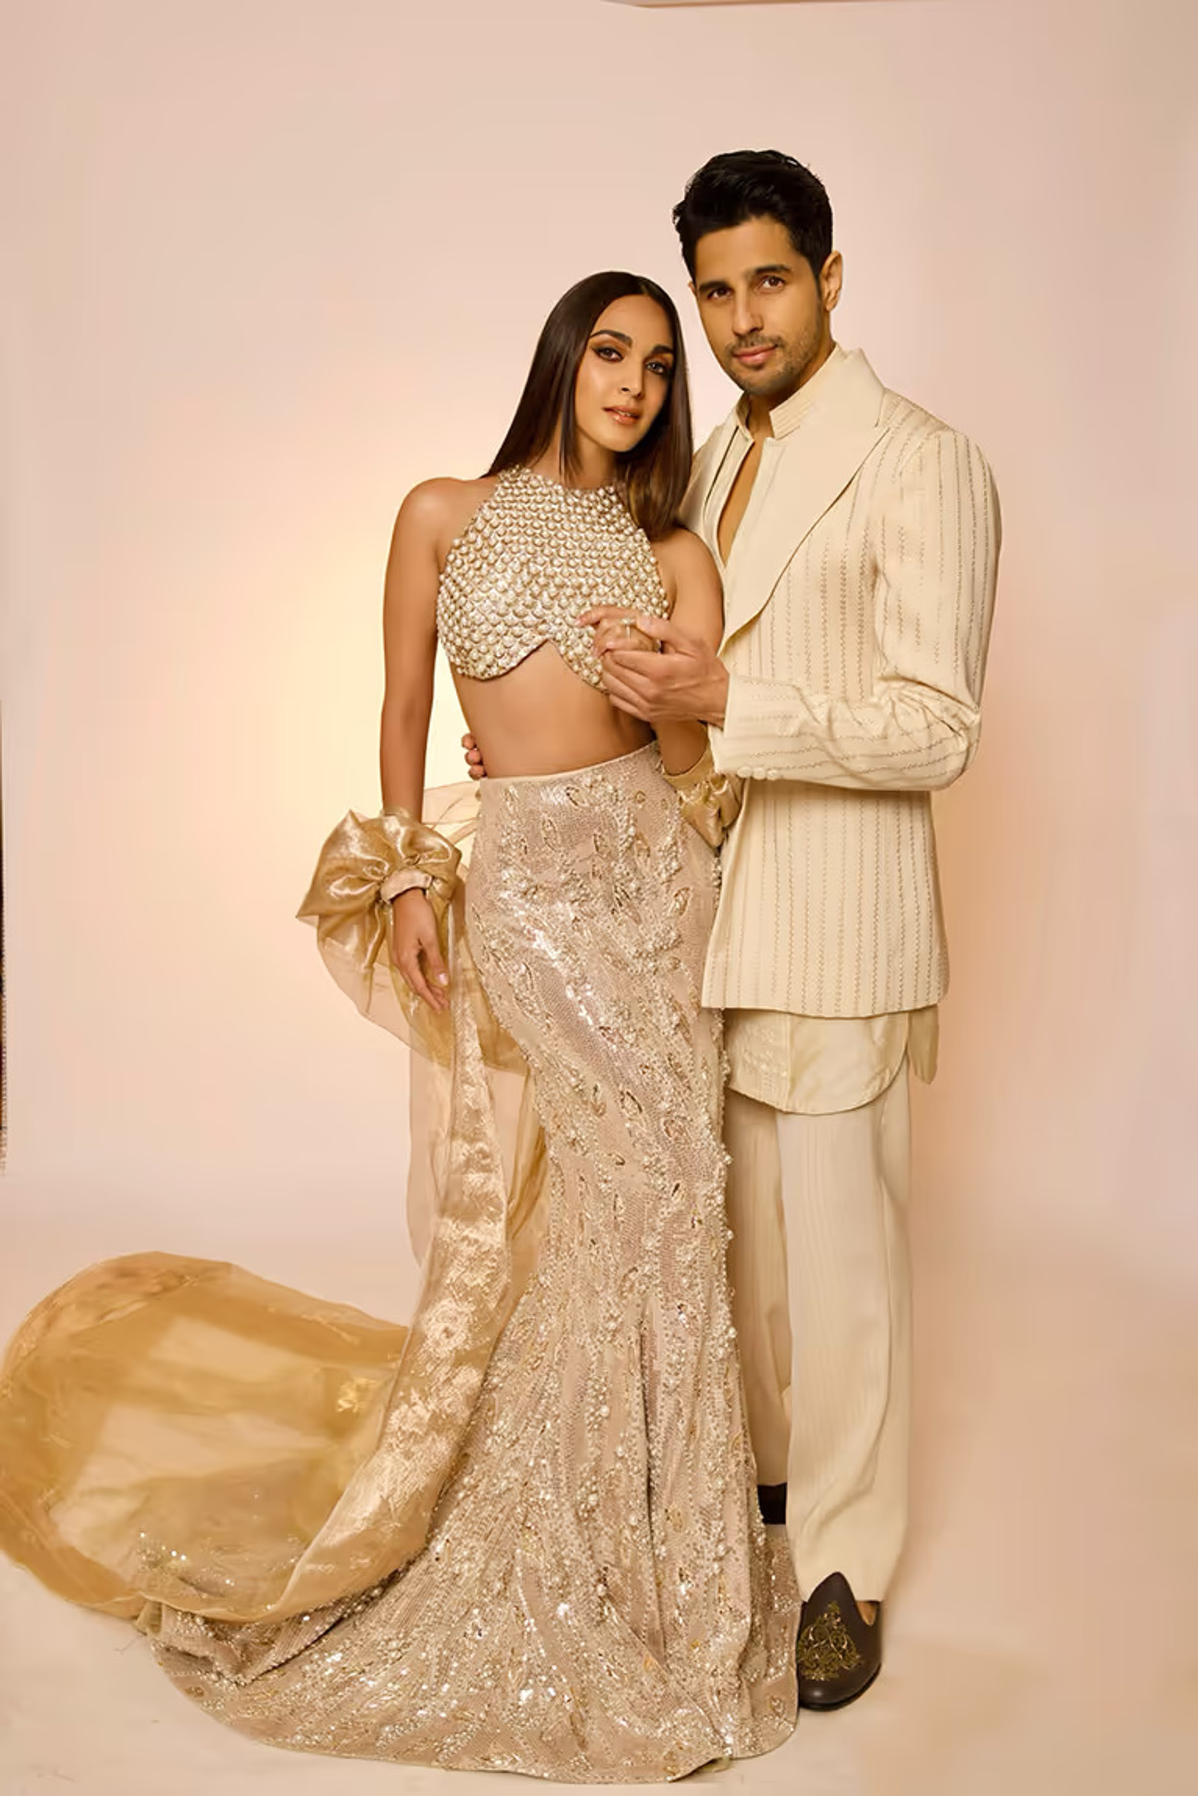
Conclusion:
Revolutionizing Celebrity Fashion Resale with Celeb Store
By combining a user-friendly platform, authentic merchandise, and a vibrant community, Celeb Store is poised to become a leading destination for celebrity fashion resale, offering fans a sustainable and exciting way to connect with their favorite stars.

Slide 15
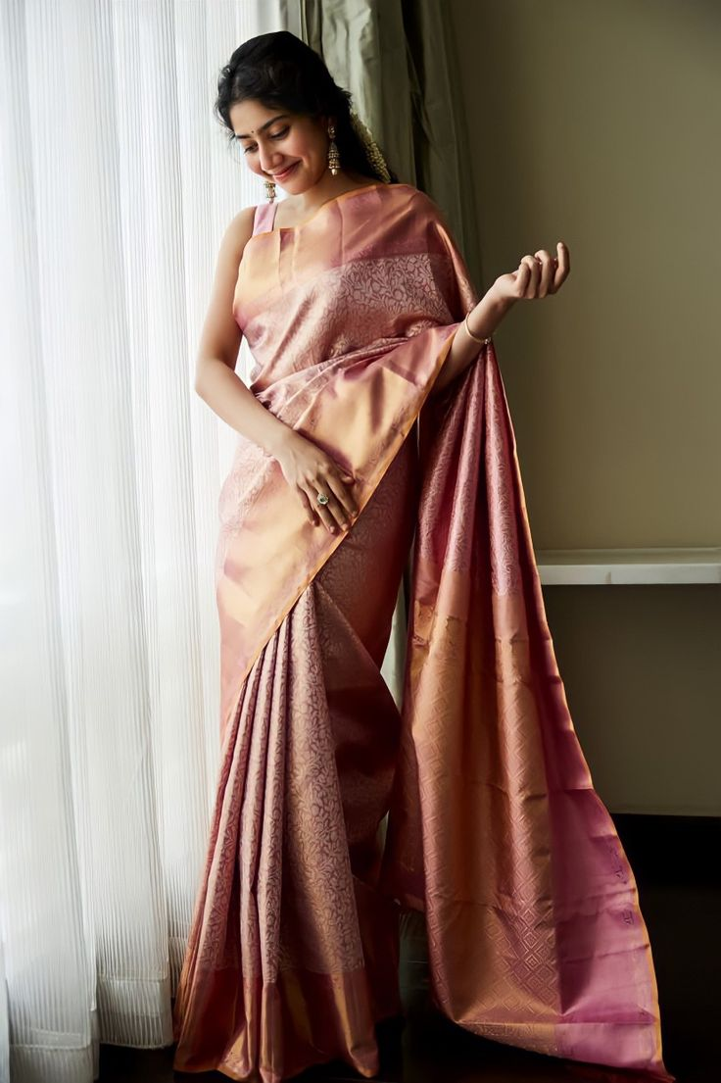
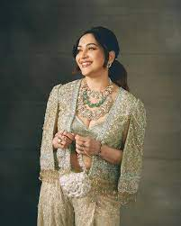

Thank You

